Slide 1


Slide 2
Chapter 7
Quality Management
Notes:
2

Slide 3
OBJECTIVES
Total Quality Management Defined
Quality Specifications and Costs
Six Sigma Quality and Tools
External Benchmarking
ISO 9000
Service Quality Measurement
Notes:
2

Slide 4
Total Quality Management (TQM)
Defined
Total quality management is defined as managing the entire organization so that it excels on all dimensions of products and services that are important to the customer
Notes:
3

Slide 5
Quality Specifications
Design quality: Inherent value of the product in the marketplace
  Dimensions include: Performance, Features, Reliability, Durability, Serviceability, Response, Aesthetics, and Reputation.
Conformance quality: Degree to which the product or service design specifications are met
Notes:
7

Slide 6

Costs of Quality
Appraisal Costs
Costs of
Quality
External Failure
Costs
Prevention Costs
Internal Failure
Costs

Slide 7

Six Sigma Quality
A philosophy and set of methods companies use to eliminate defects in their products and processes
Seeks to reduce variation in the processes that lead to product defects
The name, “six sigma” refers to the variation that exists within plus or minus three standard deviations of the process outputs

Slide 8
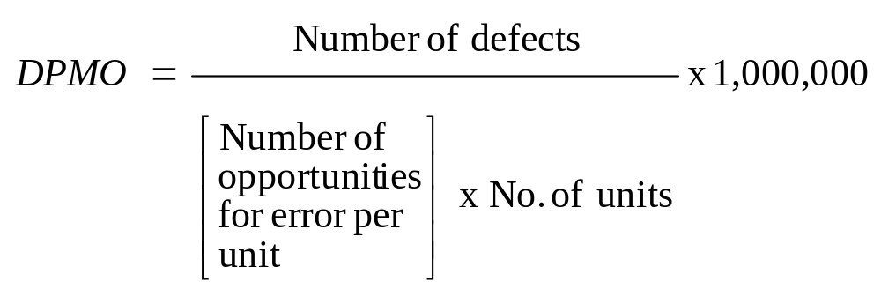
Six Sigma Quality (Continued)
Six Sigma allows managers to readily describe process performance using a common metric: Defects Per Million Opportunities (DPMO)

Slide 9
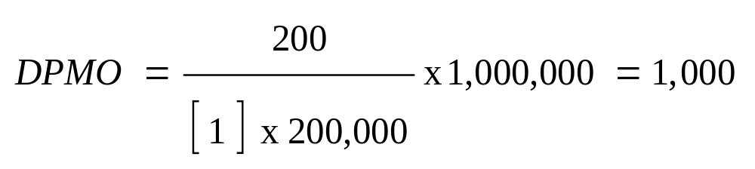
Six Sigma Quality (Continued)
Example of Defects Per Million Opportunities (DPMO) calculation. Suppose we observe 200 letters delivered incorrectly to the wrong addresses in a small city during a single day when a total of 200,000 letters were delivered. What is the DPMO in this situation?
So, for every one million letters delivered this city’s postal managers can expect to have 1,000 letters incorrectly sent to the wrong address.
Cost of Quality: What might that DPMO mean in terms of over-time employment to correct the errors?

Slide 10
Six Sigma Quality: DMAIC Cycle
Define, Measure, Analyze, Improve, and Control (DMAIC)
Developed by General Electric as a means of focusing effort on quality using a methodological approach
Overall focus of the methodology is to understand and achieve what the customer wants
DMAIC consists of five steps….

Slide 11
Six Sigma Quality: DMAIC Cycle (Continued)
1. Define (D)
Customers and their priorities
2. Measure (M)
Process and its performance
3. Analyze (A)
Causes of defects
4. Improve (I)
Remove causes of defects
5. Control (C)
Maintain quality

Slide 12
Analytical Tools for Six Sigma and Continuous Improvement: Flow Chart
Material Received from Supplier
No, Continue…
Inspect Material for Defects
Defects found?
Yes
Can be used to find quality problems
Return to Supplier for Credit
Notes:
4

Slide 13
Analytical Tools for Six Sigma and Continuous Improvement: Run Chart
Can be used to identify when equipment or processes are not behaving according to specifications
0.58
0.56
Diameter
0.54
0.52
0.5
0.48
0.46
0.44
1
2
3
4
5
6
7
8
9
10
11
12
Time (Hours)

Slide 14
Analytical Tools for Six Sigma and Continuous Improvement: Pareto Analysis
Can be used to find when 80% of the problems may be attributed to 20% of the
causes
80%
Frequency
Design
Assy.
Instruct.
Purch.
Training
Other
Notes:
12

Slide 15
Analytical Tools for Six Sigma and Continuous Improvement: Checksheet
Can be used to keep track of defects or used to make sure people collect data in a correct manner
Monday
Billing Errors
  Wrong Account
  Wrong Amount
A/R Errors
  Wrong Account
  Wrong Amount
Notes:
16

Slide 16
Analytical Tools for Six Sigma and Continuous Improvement: Histogram
Can be used to identify the frequency of quality defect occurrence and display quality performance
Number of Lots
0
1
2
3
4
Defects
in lot
Data Ranges
Notes:
14

Slide 17
Analytical Tools for Six Sigma and Continuous Improvement: Cause & Effect Diagram
Possible causes:
The results or effect
Machine
Man
Effect
Environment
Method
Material
Can be used to systematically track backwards to find a possible cause of a quality problem (or effect)
Notes:
17

Slide 18
Analytical Tools for Six Sigma and Continuous Improvement: Control Charts
Can be used to monitor ongoing production process quality and quality conformance to stated standards of quality
1020
UCL
1010
1000
990
LCL
980
970
0
1
2
3
4
5
6
7
8
9
10
11
12
13
14
15

Slide 19
Other Six Sigma Tools
Opportunity Flow Diagram used to graphically show those activities that add value from those that are performed (and maybe could be reduced or removed) that do not add value to the finished product
Failure Mode and Effect Analysis (DMEA) is a structured approach to identify, estimate, prioritize, and evaluate risk of possible failures at each stage in the process
Design of Experiments (DOE) a statistical test to determine cause-and-effect relationships between process variables and output

Slide 20
Six Sigma Roles and Responsibilities
Executive leaders must champion the process of improvement
Corporation-wide training in Six Sigma concepts and tools
Setting stretch objectives for improvement
Continuous reinforcement and rewards

Slide 21
The Shingo System: Fail-Safe Design
Shingo’s argument:
  SQC methods do not prevent defects
  Defects arise when people make errors
  Defects can be prevented by providing workers with feedback on errors
Poka-Yoke includes:
  Checklists
  Special tooling that prevents workers from making errors
Notes:
21

Slide 22
ISO 9000
Series of standards agreed upon by the International Organization for Standardization (ISO)
Adopted in 1987
More than 100 countries
A prerequisite for global competition?
ISO 9000 directs you to "document what you do and then do as you documented"
Notes:
24

Slide 23
Three Forms of ISO Certification
1. First party: A firm audits itself against ISO 9000 standards
2. Second party: A customer audits its supplier
3. Third party: A "qualified" national or international standards or certifying agency serves as auditor
Notes:
27

Slide 24
External Benchmarking Steps
1. Identify those processes needing improvement
2. Identify a firm that is the world leader in performing the process
3. Contact the managers of that company and make a personal visit to interview managers and workers
4. Analyze data
Notes:
20

Slide 25
Service Quality Measurement:Servqual
A perceived service quality questionnaire survey methodology
Examines “Dimensions of Service Quality” including: Reliability, Responsiveness, Assurance, Empathy, and Tangibles (e.g., appearance of physical facilities, equipment, etc.)
Notes:
20

Slide 26
Service Quality Measurement: Servqual (Continued)
New version of this methodology is called “e-Service Quality” dealing service on the Internet
Dimensions of Service Quality on the e-Service methodology include: Reliability, Responsiveness, Access, Flexibility, Ease of Navigation, Efficiency, Assurance/Trust, Security/Privacy, Price Knowledge, Site Aesthetics, and Customization/Personalization
Notes:
20

Slide 27
End of Chapter 7
Notes:
2

